Slide 1





Video Games Sales
Bigger Then Data (BTD)
Afnan Alzahrani (Speaker)
Jumana Almussa (Speaker)
Batool Alhajaji
Amjad Almusallam
Mahmoud Alhassan
Abdullah Alhuwaishel

Slide 2



Introduction
Our data
Dashboard

Slide 3




Our dataset
Created By Gregory Smith's, From a video game sales tracking website (Metacritic).
The fields:Game Name, Platform, YearofRelease, Genre, Publisher, North America Sales, Europe Sales, Japan Sales , Other Sales, Global Sales
Data transformation

Slide 4
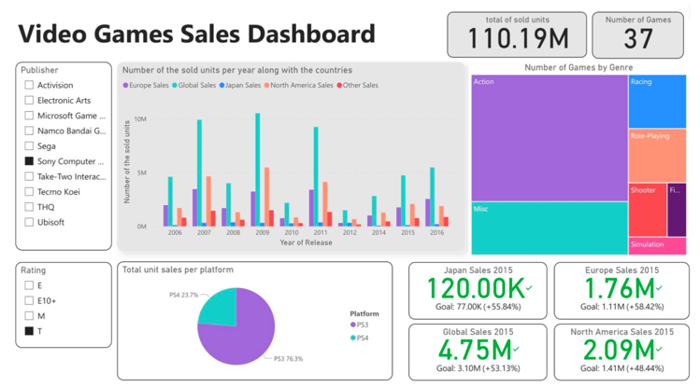

Slide 5
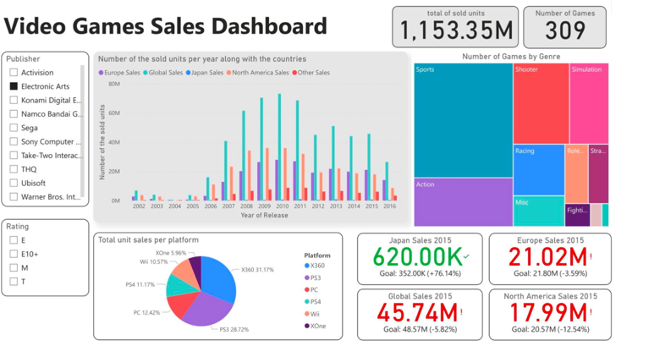

Slide 6


Thank You

